Slide 2
Welcome
Centrality measures are critical in a wide-range of applications that involve concepts/phenomena. In this workshop, we explore it's about identifying the "important" or "influential" nodes in the system.

Slide 3
Schedule
Network Science for Data Analytics
Unit 1
Introduction to Network Analysis
Unit 2
Centrality
Measures
Unit 3
Introduction to Network Models
Unit 4
Community Detection
Unit 5
Error and Attack Tolerance
Unit 6
Graph Machine Learning
Introduction to
Data Science
Basic Concepts of Graph Theory
Hubs
Communities
Vulnerability in networks
Machine Learning with Graphs
Introduction to Network Science
Small Worlds
Network Models
Deep Learning with Graphs

Slide 4
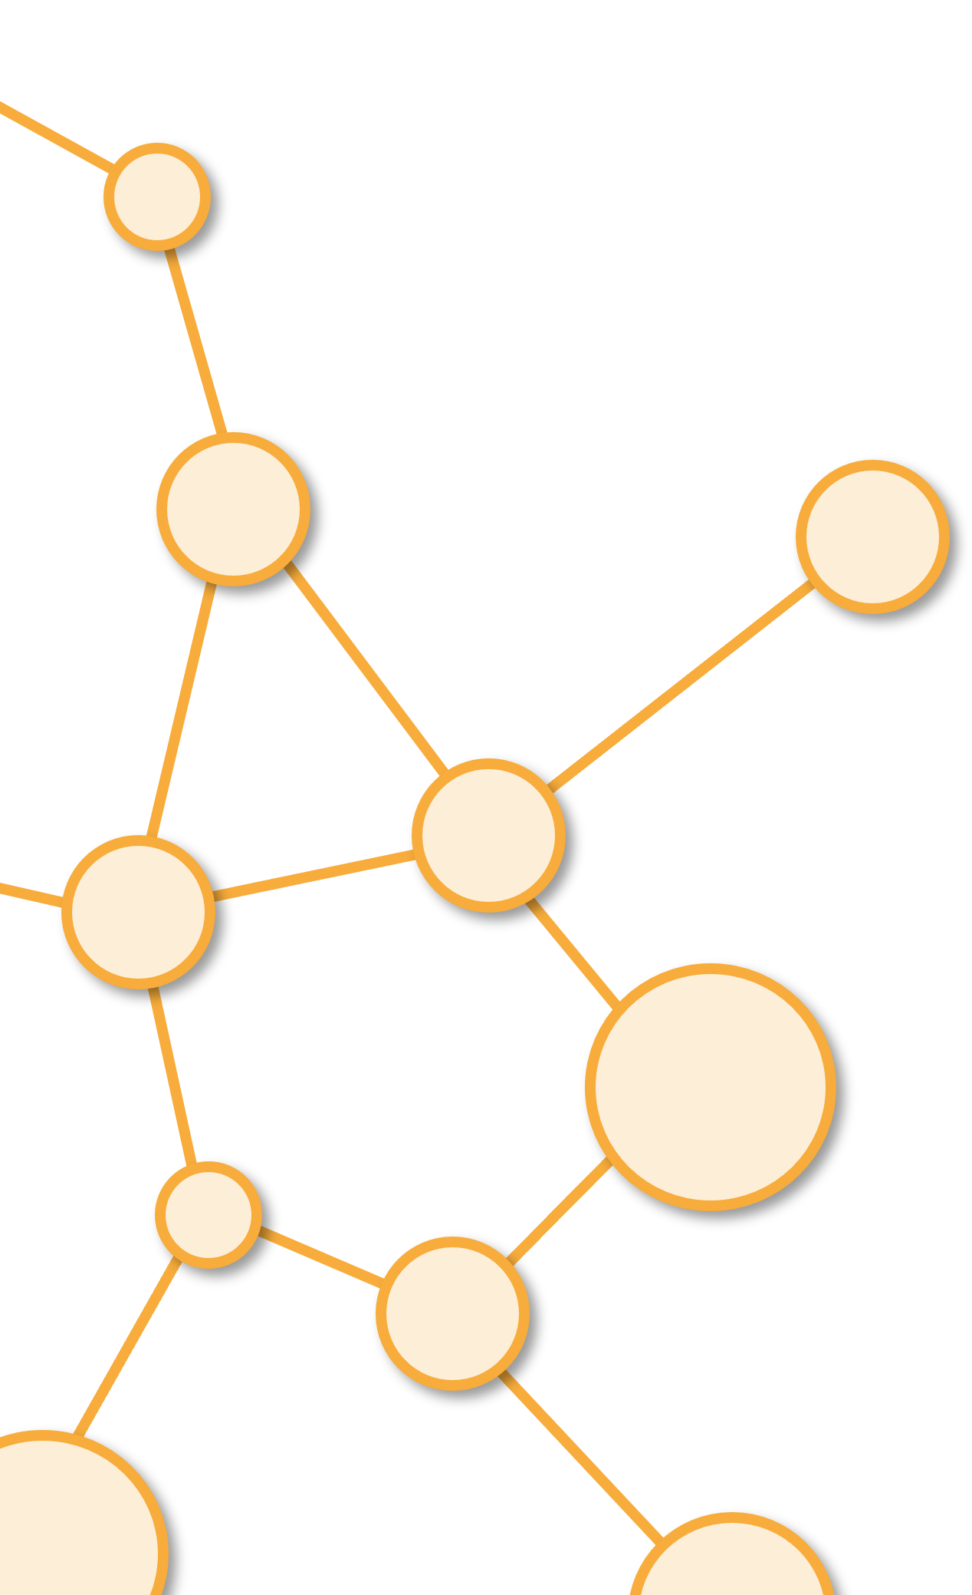
Centrality Measures Example
Unit 2

Slide 5
Question
When we look at social networks, one natural question to ask would be who is most important in the network?
Reference: Ian McCulloh, Helen Armstrong, Anthony Johnson. (2013). Social Network Analysis with Applications.

Slide 6
Centrality Measures
Degree centrality indicates the agents with the largest number of direct links to and from other agents.
Betweenness centrality measures how often a given node is on the path between other nodes
Closeness centrality measures how quickly a given node can reach all other nodes in the network
Eigenvector centrality measures how well a node is connected to other well-connected nodes.
Reference: Ian McCulloh, Helen Armstrong, Anthony Johnson. (2013). Social Network Analysis with Applications.

Slide 7
Social Network Example
Let us have a look at an example network of people who work together to see the importance of each of these measures. The following network is a network of researchers who are working on specific projects.
The nodes are people and the links represent daily consultation to discuss work matters. If people do not meet to discuss work at least once per day, then there is no link between them. As people meet together, the relationship is reciprocated. That means that the links will be undirected.
Reference: Ian McCulloh, Helen Armstrong, Anthony Johnson. (2013). Social Network Analysis with Applications.

Slide 8
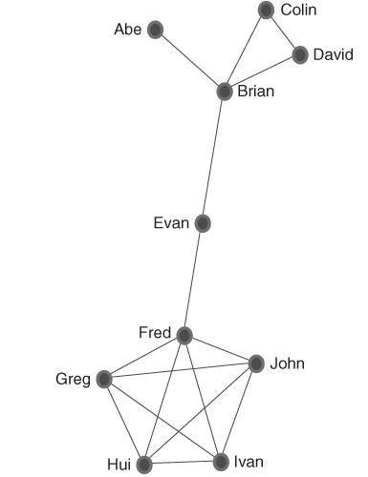
Topology of the Social Network
Reference: Ian McCulloh, Helen Armstrong, Anthony Johnson. (2013). Social Network Analysis with Applications.

Slide 9
First Analysis
Fred has the highest degree centrality, so he has a direct link to the highest number of people in the network. Fred has a total of 10 links to other people. We must remember to count both in and out links because the relationship are reciprocated. This means that Fred is central to the network and can directly influence most people. Fred could be considered a “hub” as he has the largest number of people connecting to him. Abe has a total degree centrality of 2, which is the least number of connections as he only connects with Brian. In the real world, Abe could be working on a special task, or he could be isolated from the others like, say, a remotely located subcontractor. Brian, Greg, Hui, Ivan, and John, on the other hand, they all have a total degree centrality of 8 because they all discuss matters with each other and Fred on a daily basis. They form a nice coherent group, but no one other than Fred has any connections to the others in the organization. Even Fred does not have a direct connection to Brian, Abe, Colin, and David. Although, one might think that having a high degree gives dominance or power this is not always the case. A high total degree centrality does not necessarily mean significant power. It just indicates how strong the links are with adjacent nodes.
Reference: Ian McCulloh, Helen Armstrong, Anthony Johnson. (2013). Social Network Analysis with Applications.

Slide 10
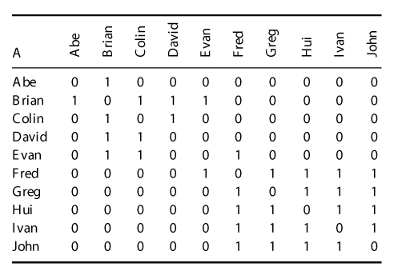
Adjacency Matrix of the Network
Reference: Ian McCulloh, Helen Armstrong, Anthony Johnson. (2013). Social Network Analysis with Applications.

Slide 11
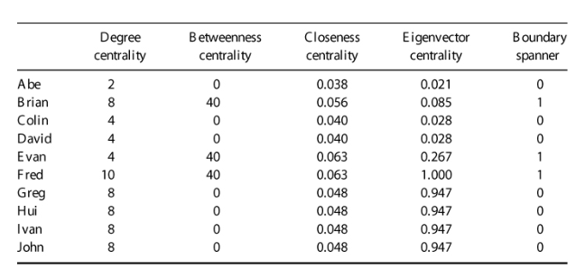
Centrality Table of the Network
Reference: Ian McCulloh, Helen Armstrong, Anthony Johnson. (2013). Social Network Analysis with Applications.

Slide 12
Betweenness Centrality
Betweenness centrality measures how often a given node is on the path between other nodes. It indicates the amount of control a node has over what passes through to other parts of the network. Brian, Evan, and Fred are high in betweenness in this network as they are on the path that flows between the other people. Hence, they are brokers because they control what can flow (or not flow) through them to other parts of the network. Abe must go through Brian to contact anyone else in the network. The links between Colin and David are local and both must also go through Brian to contact the others in the network. Similarly, the links between Greg, John, Ivan, and Hui are also local and all must go through Fred to connect with other people in different parts of the network. Fred is well located with regard to betweenness as well as degree, but he is also a single point of failure. If he is absent or chooses to not pass on information, then the network could fragment. He may also choose to misrepresent information or pass on only selected parts of important information. Note that from the previous Table, Fred, Brian, and Evan, all have betweenness scores of 40. Of the three, however, Fred can be considered the more significant of the three because its degree centrality is greater.
Reference: Ian McCulloh, Helen Armstrong, Anthony Johnson. (2013). Social Network Analysis with Applications.

Slide 13
Closeness Centrality
Closeness centrality measures how quickly a given node can reach all other nodes in the network and indicates how readily a node can access information and flows that are available from the network. Evan and Fred have the highest closeness measures, indicating they are the closest to all other people in the network. Hence, they can reach all the nodes in the network more efficiently than others. If you need to disperse information quickly across the network, then Evan and Fred can do this more effectively. Those with high closeness have the best view of what is happening in the network.
Reference: Ian McCulloh, Helen Armstrong, Anthony Johnson. (2013). Social Network Analysis with Applications.

Slide 14
Closeness and Betweenness
People in the network with high betweenness and high closeness are in a position where they have easy access to others in the network, while at the same time being able to control what is filtered through to other sections of the network. In this research network, we see that Evan and Fred have the highest closeness and betweenness scores, thus giving them some power over the others. Brian is also high in betweenness and closeness, and informally can exert some power.
Reference: Ian McCulloh, Helen Armstrong, Anthony Johnson. (2013). Social Network Analysis with Applications.

Slide 15
Eigenvector Centrality
Eigenvector centrality measures how well a node is connected to other well-connected nodes. In this network, Fred has an eigenvector of 1, the maximum obtainable. Fred is directly connected to Evan who is connected to Brian and the smaller research group, and he is connected to Greg, Ivan, Hui and John, who are all well connected within the larger research cluster. Greg, Hui, Ivan and John are also high in eigenvector as they are connected to each other and Fred who are all well connected. The people least connected to well-connected nodes are Abe, Colin, and David as they have the lowest eigenvector scores.
Reference: Ian McCulloh, Helen Armstrong, Anthony Johnson. (2013). Social Network Analysis with Applications.

Slide 16
A New Situation
Let us look at the situation where Fred becomes aware that Brian and/or Evan are filtering information he gets from the smaller research cluster. In order to have reliable research results, Fred needs reliable and accurate information. He directly approaches David to gain more information. We now have a link between Fred and David and the network structure has changed slightly. No longer are the two clusters separated.
Reference: Ian McCulloh, Helen Armstrong, Anthony Johnson. (2013). Social Network Analysis with Applications.

Slide 17
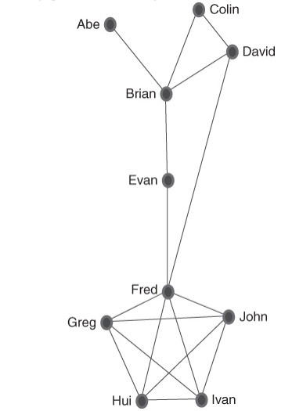
New Network
Reference: Ian McCulloh, Helen Armstrong, Anthony Johnson. (2013). Social Network Analysis with Applications.

Slide 18
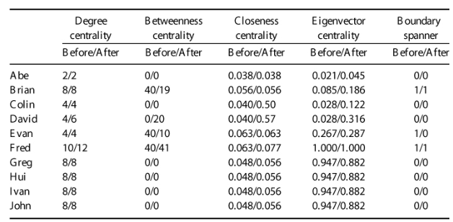
New Centrality Table
Reference: Ian McCulloh, Helen Armstrong, Anthony Johnson. (2013). Social Network Analysis with Applications.

Slide 19
New Analysis
Brian and Evan have clearly lost influence in the network, as reflected in the decrease in their betweenness scores. David's betweenness score has risen notably from 0 to 20 and Fred's from 40 to 41, making him the most influential in terms of betweenness. Colin and David are now higher in closeness, making it easier for them to directly contact others in the network. Fred is also higher in closeness as are all the members of Fred's cluster.
Reference: Ian McCulloh, Helen Armstrong, Anthony Johnson. (2013). Social Network Analysis with Applications.

Slide 20
Evan and Brian
The removal of Evan or Brian in the old network structure would be devastating to the cohesion of the network, as removal of either would fragment the network into smaller unconnected groups and isolates. In the new network structure, the removal of Evan or Brian would not break the network apart. The new link between Fred and David has taken away the single point of failure observed in the old network structure. However, the removal of Fred from the network would still separate the network into two unconnected subnetworks.
Reference: Ian McCulloh, Helen Armstrong, Anthony Johnson. (2013). Social Network Analysis with Applications.

Slide 21
Other Situation
Each additional relationship that Fred makes will require an investment of his time and energy. It may not be feasible for Fred to consult with every individual within the network, or his current relationships may consume all of his time. This will require Fred to be selective with regard to the connections he makes. In time, he may drop connections with Greg, Hui, Ivan, or John. These four individuals are structurally equivalent, meaning that they are connected to exactly the same alters. Thus, Fred’s connections to these four individuals is likely to provide the same information and access to resources. In contrast, the connection to David provides access to a different part of the network. If Fred drops the connection to John, the network structure again changes.
Reference: Ian McCulloh, Helen Armstrong, Anthony Johnson. (2013). Social Network Analysis with Applications.

Slide 22
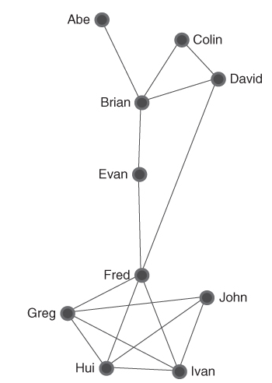
New Network
Reference: Ian McCulloh, Helen Armstrong, Anthony Johnson. (2013). Social Network Analysis with Applications.

Slide 23
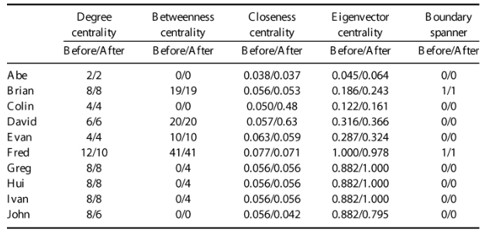
New Table
Reference: Ian McCulloh, Helen Armstrong, Anthony Johnson. (2013). Social Network Analysis with Applications.

Slide 24
New Analysis
The centrality scores for John are reduced because of the lost connection to Fred. Fred must now access the rest of the network through his connections to Greg, Hui, or Ivan. In turn, their centrality scores have increased. While Fred's degree centrality has become lower, as he is no longer connected to John, his betweenness centrality remains unchanged. Therefore, Fred is able to maintain power in the network in terms of his ability to control information and access resources, yet he has a lower cost in terms of time and effort to maintain consultation with John.
Reference: Ian McCulloh, Helen Armstrong, Anthony Johnson. (2013). Social Network Analysis with Applications.

Slide 25
Conclusion
While degree centrality may appear at first to look like an intuitive measure of influence, it can often be misleading.
In the simple example provided, degree centrality represents a social cost of time and effort. Rather than influence, it is more a measure of constraint and loss of freedom of action.
Betweenness centrality provides a more effective measure of power in the network.
So we can see that location in the network is very important for those people who either seek to be informed, collect information available via the network, or those who are presented with opportunities to control information flows across the network.
Reference: Ian McCulloh, Helen Armstrong, Anthony Johnson. (2013). Social Network Analysis with Applications.

Slide 26
Summary
Measures of centrality give us information regarding the position of agents within a network as well as the importance and influence that this position affords them. However, it must be borne in mind that the strength of an agent's location in the network as indicated by its centrality measures will depend on how the links are defined and measured. With any research, care must be taken in the definition of data and how it is measured. The famous saying “garbage in garbage out” is highly pertinent in network analysis.
Your results will only be as reliable as the data used as the basis for the analysis.
Reference: Ian McCulloh, Helen Armstrong, Anthony Johnson. (2013). Social Network Analysis with Applications.

Slide 27
Summary
Centrality measures of degree, betweenness, closeness, and eigenvector can tell us how much influence agents have within their network. Degree centrality indicates how many agents connect directly to the agent under study. Betweenness centrality reports how frequently an agent is on paths that are between other agents. Closeness centrality indicates how close an agent is to all the other agents in the network. Eigenvector centrality portrays how well connected our agent is to other well connected agents.
Reference: Ian McCulloh, Helen Armstrong, Anthony Johnson. (2013). Social Network Analysis with Applications.

Slide 28
Summary
Degree centrality indicates the agents with the largest number of direct links to and from other agents.
Betweenness centrality measures how often a given node is on the path between other nodes and indicates the amount of control a node has over what passes through to other parts of the network.
Reference: Ian McCulloh, Helen Armstrong, Anthony Johnson. (2013). Social Network Analysis with Applications.

Slide 29
Summary
Closeness centrality measures how quickly a given node can reach all other nodes in the network
and indicates how readily a node can access information and flows that are available from the network.
Eigenvector centrality measures how well a node is connected to other well-connected nodes.
Eigenvector emphasizes the saying, “It is not what you know but who you know.”
Reference: Ian McCulloh, Helen Armstrong, Anthony Johnson. (2013). Social Network Analysis with Applications.

Slide 30

Brin and Page
“The position of agents in the network and their centrality will affect how much importance and influence they have”
(Brin and Page, 1998).
Reference: Photo of Larry Page y Sergey Brin. https://www.tycsports.com/interes-general/google-cumple-25-anos-por-que-lo-recuerda-en-su-doodle-id537904.html

Slide 31
Good bye
We hope that the information in this study material has contributed to the understanding of the most important concepts of this topic.
We invite you to continue reviewing all the educational materials available on the platform.

Slide 32
Image copyright
Photo of Larry Page y Sergey Brin. https://www.tycsports.com/interes-general/google-cumple-25-anos-por-que-lo-recuerda-en-su-doodle-id537904.html

Slide 33
References
Ian McCulloh, Helen Armstrong, Anthony Johnson. (2013). Social Network Analysis with Applications.
Dr. Ian McCulloh. YouTube Channel. https://www.youtube.com/@dr_smoke/videos

Slide 34
Credits
Subject Matter Expert
Instructional Designer
Jorge Alfonso Meléndez Acuña
Angela Maria Arboleda Restrepo
Subject Matter Expert
Graphic Designer
Luis Fernando Niño Vásquez
Tania Valentina Flórez Rincón
First version
Date: April 2025

